Slide 1












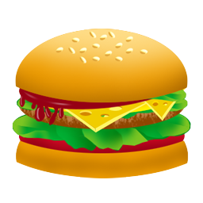
Fill
Find
x
S
f
d
o
o

Slide 2

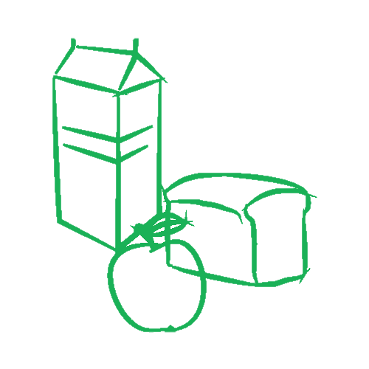

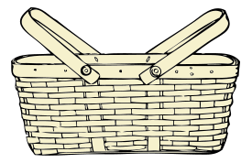


Donate
Donate
Donate
Food

Slide 3
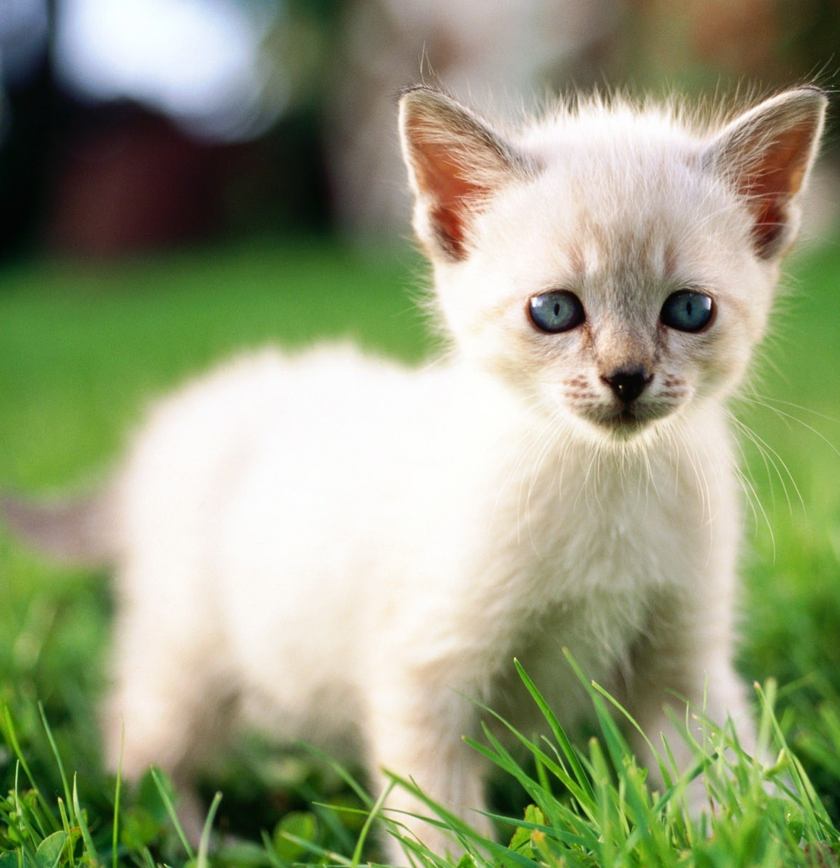
Always scares away a rat, Enjoys sleeping on a mat, Drinks milk until its fat, plays 'hide and seek' under my hat
Until near it I sat, It's soft fur to pat. Toffy is my pet cat!
- WW

Slide 4
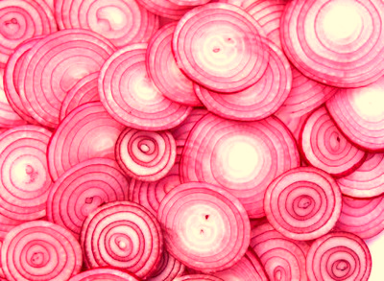
Inside the kitchen when I pry,
I see peels papery and dry!
Watching the chopping makes me cry...
But after each bite I try,
"Onion pairs well with any fry!"

Slide 5


Slide 6
Donate

Slide 7




xS
food
xSfood

Slide 8


Slide 9

Excess Food Extended

Slide 10



F
D
ME
ME
ME

Slide 11
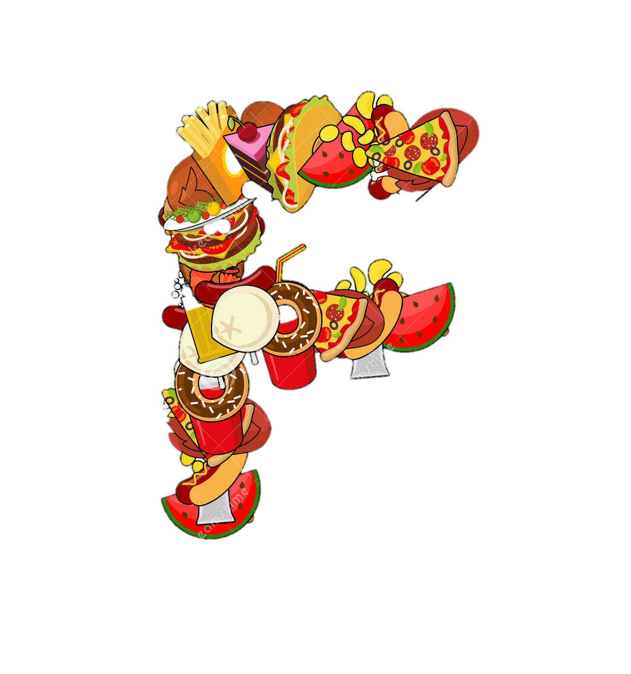
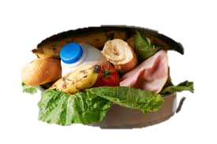
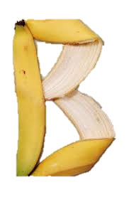




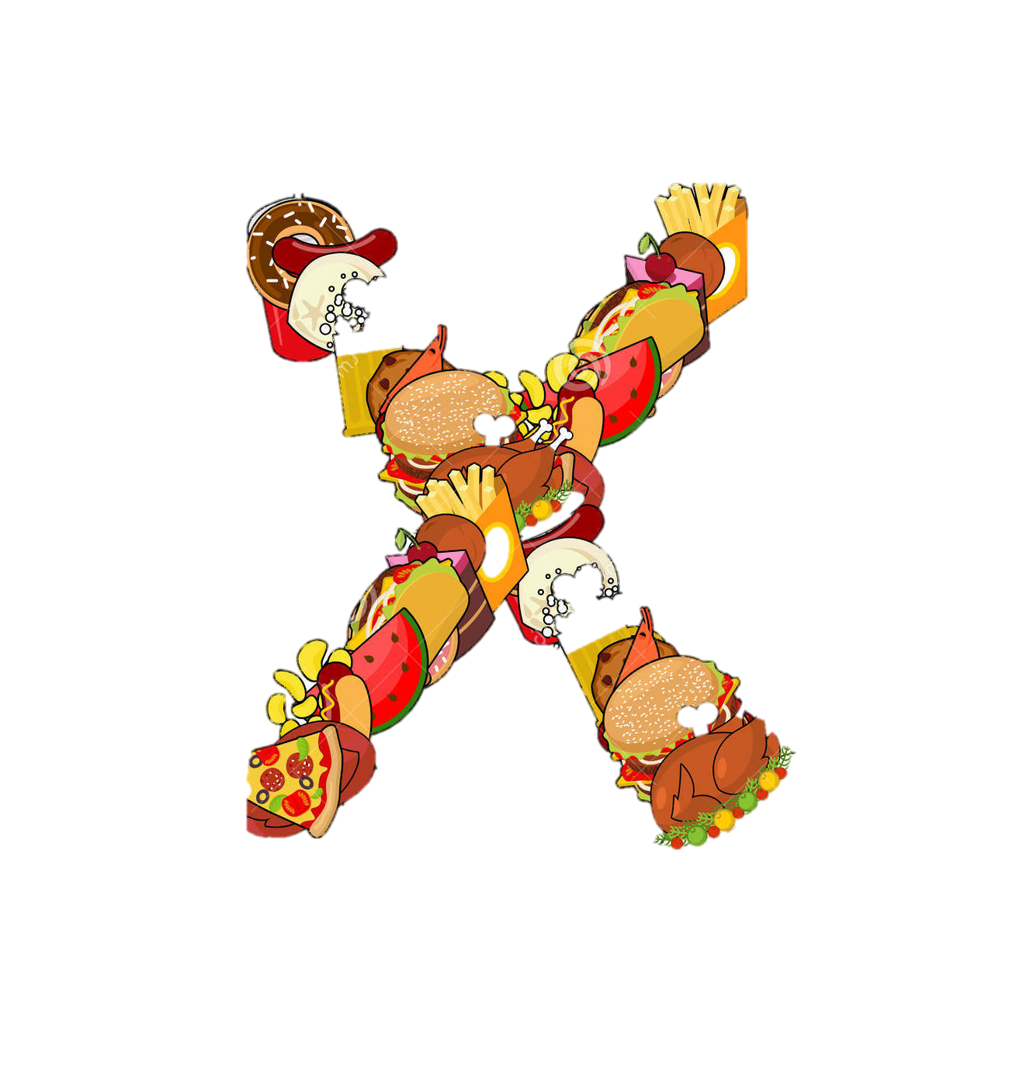

Slide 12


Slide 13
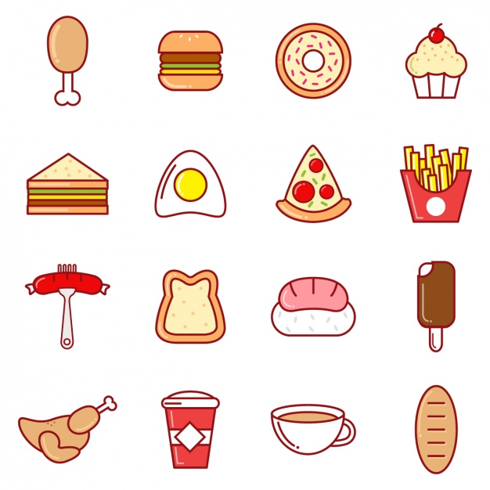

Slide 14


Slide 15


x
S
f
d
o
o

Slide 16



x
s
f
d
o
o
Share your

Slide 17



Download
Download
App Store

